Slide 1




COMPANY PROFILE
RMC2
CONSULTANCY CORP
Your trusted partner in Health, Life and Non-Life Coverage
www.rmc2consultancycorp.com

Slide 2


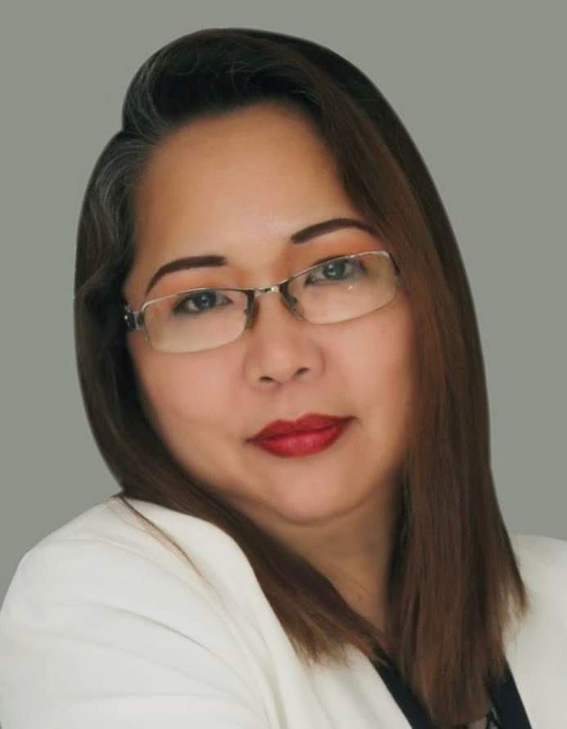
WHO WE ARE
At RMC2 Consultancy Corp, we believe that health and financial security should be accessible to everyone. Founded by Rosemarie Fernandez, who has been in the insurance industry for over 23 years, RMC2 was established with a passion for making a difference. Rosemarie has been exposed to the various needs of the market and decided to create a bridge for Filipinos who are overwhelmed by the process of insurance, making it more accessible and understandable.
We specialize in providing affordable, convenient, and reliable HMO, Life, and Non-Life Insurance solutions tailored to meet diverse needs.
Our mission is simple: to bridge the gap between people and quality healthcare by offering plans that prioritize accessibility and peace of mind. We understand that navigating insurance options can be overwhelming — that's why we take pride in guiding our clients every step of the way, ensuring clarity, compassion, and personalized service.
With a commitment to building lasting relationships, RMC2 Consultancy Corp stands as a trusted partner in safeguarding the well-being and future of individuals, families, and businesses alike.
Let us help you protect what matters most.

Slide 3

ABOUT US
At RMC2, we are dedicated to redefining the insurance experience. We specialize in providing HMO, Life, and Non-Life Insurance solutions that put people first, ensuring that protection isn’t just a privilege but a right for all. Our approach is built on three core principles: Affordability, Accessibility, and Convenience.
We understand that navigating insurance can feel overwhelming, so we’ve made it our mission to simplify the process. From personalized plans to hassle-free assistance, we’re here every step of the way, helping individuals, families, and businesses secure their future with peace of mind.
At the heart of RMC2 is a commitment to building lasting relationships. Whether it’s ensuring quick access to healthcare or offering life protection tailored to your needs, we’re more than just an insurance provider.
We are your trusted partner in safeguarding what matters most which is protecting lives and empowering futures.

Slide 4

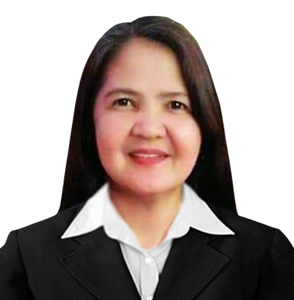


THE MANAGEMENT
ROSEMARIE FERNANDEZ
PRESIDENT & CEO
MICHELLE GUINTO
CHERRY CORTEZ
CLEMENT DOLF FERNANDEZ
CHARLES MARK UYBENGKEE
BOARD OF DIRECTOR
BOARD OF DIRECTOR
BOARD OF DIRECTOR
BOARD OF DIRECTOR

Slide 5

VISION
& MISSION
V > To break barriers where quality health and life protection is within everyone’s reach, ensuring affordability and accessibility for all.
M > To safeguard lives by delivering affordable and accessible HMO, Life, Non-Life Insurance solutions, ensuring everyone has the security and care they deserve.

Slide 6













OUR
PARTNERS
IN HEALTH

Slide 7





OUR
PARTNERS
IN LIFE

Slide 8







OUR
PARTNERS
IN NON-LIFE

Slide 9
















CLIENTS
WE SERVED
AND MORE

Slide 10


OUR GROWING NETWORK
RMC2 CONSULTANCY CORP
A growing consultancy firm for insurance solution with a strong client network, committed to promoting wellness, preventive health, and lifestyle benefits for its members.
1,200
15,300
900
SALES ADVISORS
GROUP ENROLLEES
INDIVIDUAL ACCOUNT
*DATA FROM
SEPTEMBER 2024 - NOVEMBER 2025

Slide 11

OUR
OFFICES
LUZON:
Cainta - HEAD OFFICE
Antipolo
Taytay
Bulacan
Valenzuela
Lipa
Pampanga - OPENING SOON
La Union
Baguio
Isabela
Bicol - OPENING SOON
Quezon City 1 & 2
Ilagan - OPENING SOON
VISAYAS:
Mandaue City - REGIONAL HEAD OFFICE
Cebu City - OPENING SOON
MINDANAO:
General Santos City

Slide 12









RMC2 PRODUCTS
IN PARTNERSHIP WITH AMAPHIL

Slide 13


PARTNERSHIP PERKS

Slide 14



OUR NETWORK PROVIDER
Nationwide hospital and clinic accreditation thru our network provider AMAPHIL
AMAPHIL, or Advanced Medical Access Philippines, Inc., is a technology-powered Third Party Administrator (TPA) that was founded in 2016 to manage self-funded corporate health plans. It connects members to a large network of accredited hospitals, clinics, and physicians, and provides technology-driven services like online consultations via the Doctor Anywhere app. AMAPHIL's goal is to provide cost-effective, high-quality healthcare solutions for companies and their employees
www. amaphil.com.ph

Slide 15
OUR NETWORK PROVIDER
Corporate Officers
Ms. Irene Cara Gatus
Chairman
Ms. Mylene Benitez
Treasurer
Ms. Angeles Ongchangco
Corp Secretary
Ms. Mariane Odi
Board of Director
Atty. Ensign Icamen
Board of Director
www. amaphil.com.ph

Slide 16

Introducing:
ManpowER Protect Plus
The plan covers medical emergencies, life-threatening conditions, and sudden illnesses or injuries requiring immediate medical attention within 24 hours. Covered cases include, but are not limited to, fractures, severe burns, allergic reactions, and asthma attacks. Confinement following emergency treatment is also covered when medically required.

Slide 17
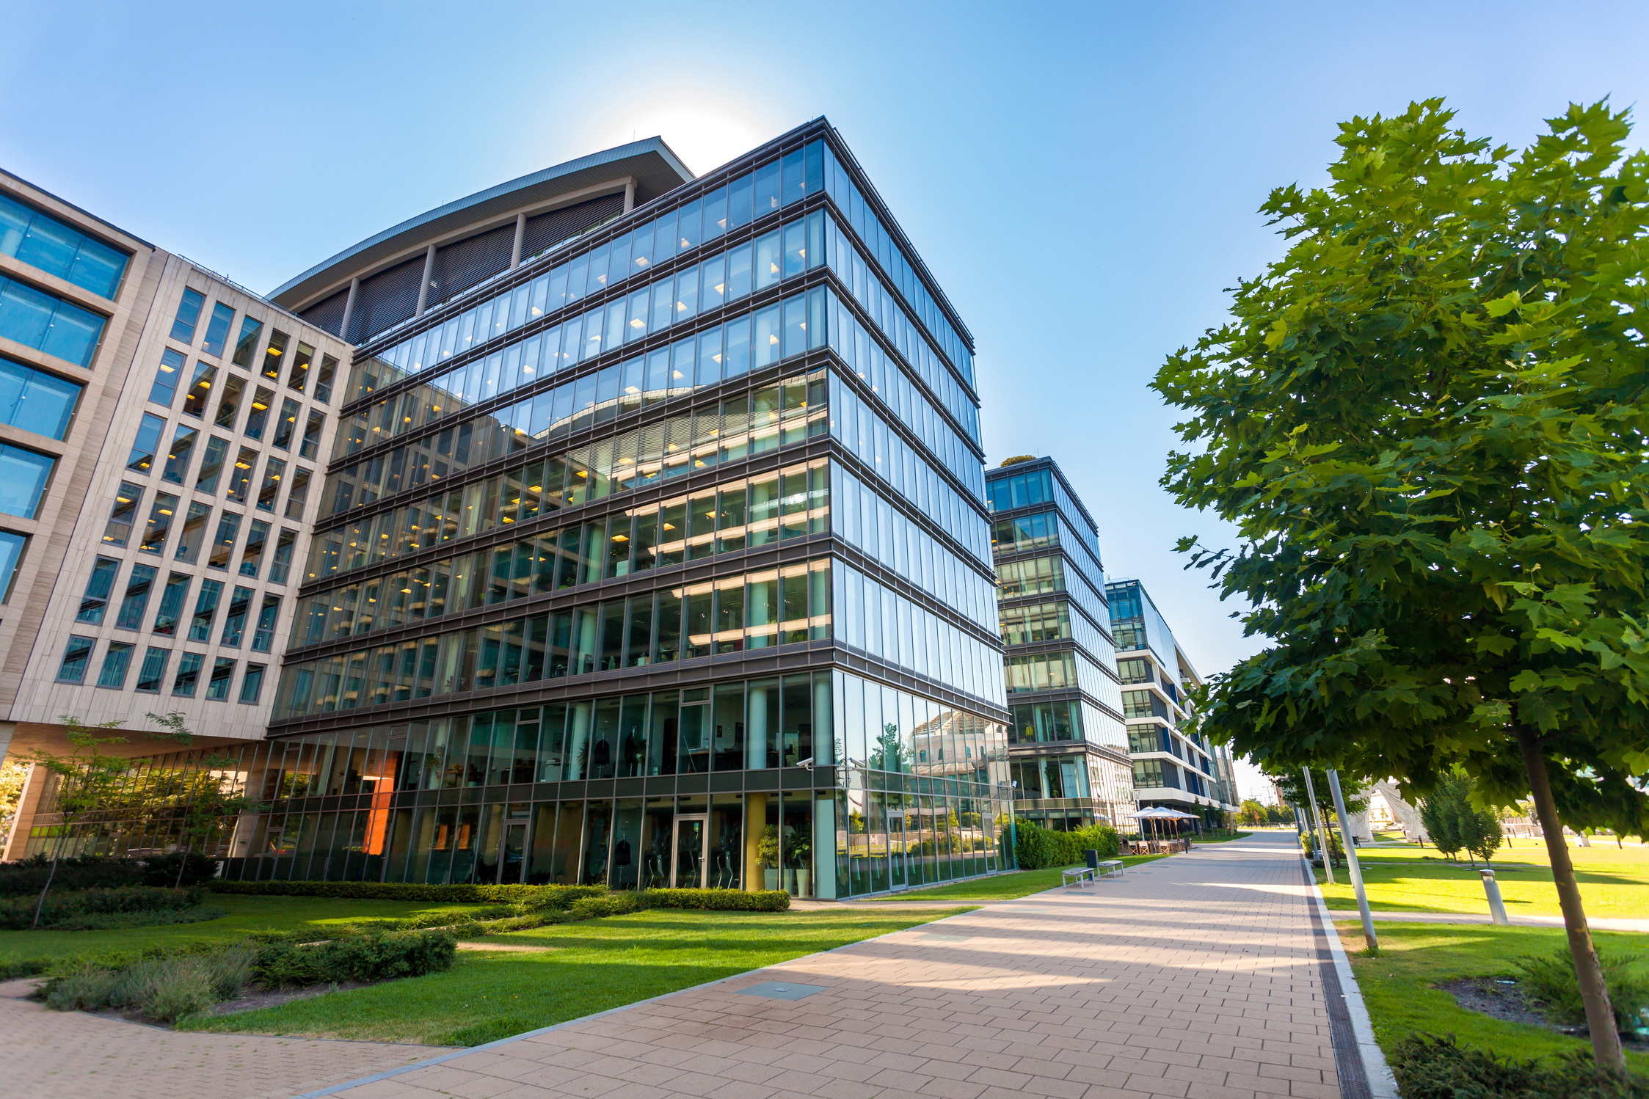
ELEGIBILITY
Open to manpower agencies with at least 20 employees
PRINCIPAL
EMPLOYEES | ENTRY AGE | LAST AGE ACCEPTANCE | EXIT AGE
 | 16 | 60 | 61
Validity: One (1) year from activation date.
No Medical Screening Required: No prior checkups or paperwork necessary for activation.
Hospital Access: Available in all AMAPHIL-accredited hospitals nationwide, including six (6) major hospitals.

Slide 18
EMERGENCY BENEFITS
Outpatient Emergency Benefits
Emergency consultation and physician’s fees
ER facility and treatment fees
Emergency medicines for immediate care
(excluding take-home medications)
Oxygen, IV fluids, whole blood, and human blood
products
Dressings, sutures, and casts
X-ray, laboratory, and diagnostic tests

Slide 19
In-Patient Benefits
(ER Leading to Confinement)
• Room and board in a given room based on the availed plan.
• Operating Room, ICU, Isolation Room, and Recovery Room use (if
prescribed)
• Professional fees and standard nursing services
• Medicines and IV fluids during confinement
• Laboratory, X-ray, and diagnostic procedures
• Anesthesia and oxygen administration
• It must be ER-leading to confinement.

Slide 20
Outpatient Benefits
• Consultation with Accredited AMAPHIL doctors
based on the plan limit.
• Outpatient Laboratory tests to Accredited
hospitals and clinics based on plan limit, and
must be prescribed by the accredited AMAPHIL
doctor.

Slide 21

ANNUAL PHYSICAL EXAM
COVERED for all Variants
Physical Examination
Complete Blood Count
Urinalysis
Fecalysis
Chest X-ray
Can be availed at AMAPHIL accredited clinics with APE arrangements.

Slide 22
General Conditions
The card is non-transferable once registered
Membership is valid for one (1) year from activation date
Presentation of a valid government-issued ID and the manpowER Protect Plus card/ digital card is required during availment
Members may only avail services from one AMAPHIL-accredited provider.
Any balance remaining after usage is non-convertible to cash. PhilHealth required.
Only one card can be active at any given time; subsequent cards may be registered 15 days after availment, or 1 day after expiration (if unused)

Slide 23
Plan Name | Premium / Year | Out Patient | Out Patient Laboratory | APE | ER Leading to Confinement (One Time) | Room & Board | PEC
ER MAN 20 | PHP 2,500 | 2 Consults/year | PHP400 | Basic Five | PHP20,000 | Ward | Not Covered
ER MAN 30 | PHP 3,000 | 2 Consults/year | PHP600 | Basic Five | PHP30,000 | Ward | Covered after 6 months
ER MAN 40 | PHP 3,500 | 3 Consults/year | PHP800 | Basic Five | PHP40,000 | Semi-Private | Covered after 6 months
ER MAN 50 | PHP 4,000 | 4 Consults/year | PHP1000 | Basic Five | PHP50,000 | Semi-Private | Covered after 6 months

Slide 24

GENERAL EXCLUSIONS
Non-emergency medical services or elective treatments
Hospital upgrades and extended stays beyond prescribed limits
Non-medical expenses, such as personal items and special nursing services
Psychiatric and developmental disorders
Self-inflicted injuries, substance abuse, and criminal acts
Cosmetic, dental, and reproductive procedures (except when related to emergency injury)

Slide 25
GENERAL EXCLUSIONS
Chronic, congenital, and genetic conditions, including hypertension, diabetes, and related illnesses
Preventive and routine care, such as annual physical exams, vaccinations, and screening tests
Pandemic and epidemic-related illnesses, including COVID-19
Costs beyond the availed benefit limit
Medico-legal expenses

Slide 26


Slide 27


THANK YOU!

